Slide 1
Data Visualization & Mining on Music Track Features
Islam Anwar

Slide 2
Agenda
Dataset
Data Visualization & Mining Techniques
Univariate Visualization
Linear Discriminant Analysis (LDA)
Cluster Analysis
Hierarchical
K-Means
Hotelling’s T Test
Principal Component Analysis (PCA)
Multidimensional Scaling (MDS)
CanCor
Measures of Association
Outlier Detection, Comparison after outlier removal
Conclusion

Slide 3
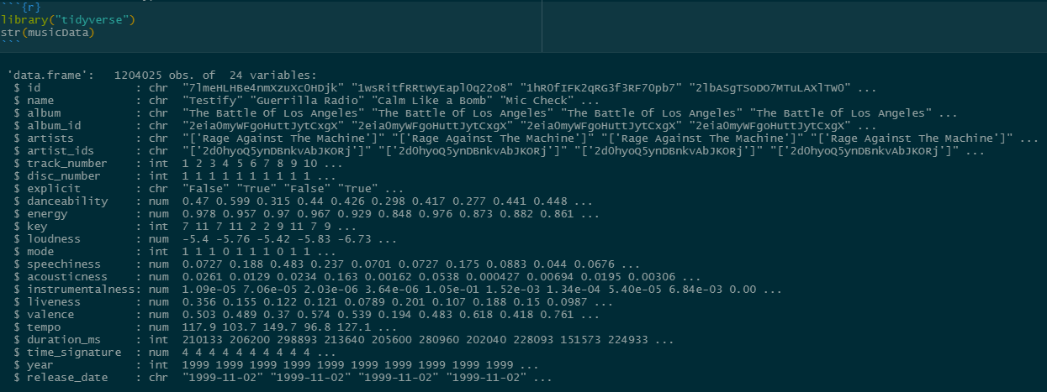
Spotify Dataset
1.2 million songs
For computational capabilities, only 5000 observations are used.

Slide 4
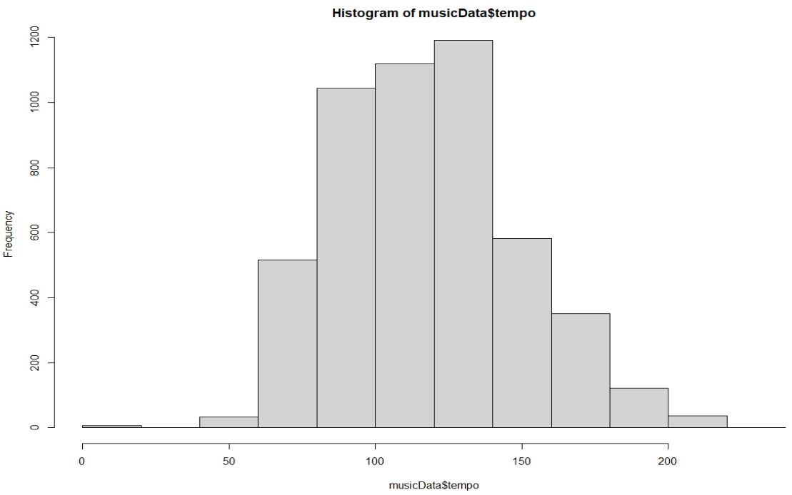
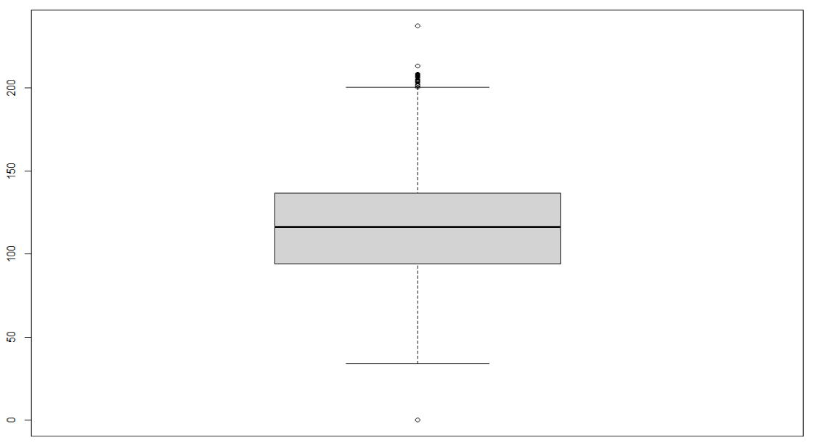
Univariate Visualization

Slide 5
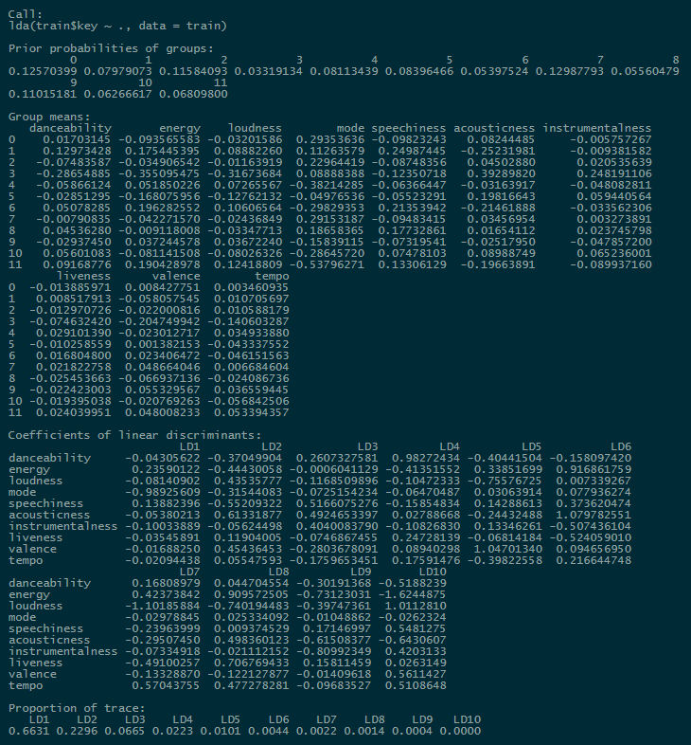
Linear Discriminant Analysis (LDA)
Performed data scaling
Train-test split of 70-30
MSE of 0.15

Slide 6
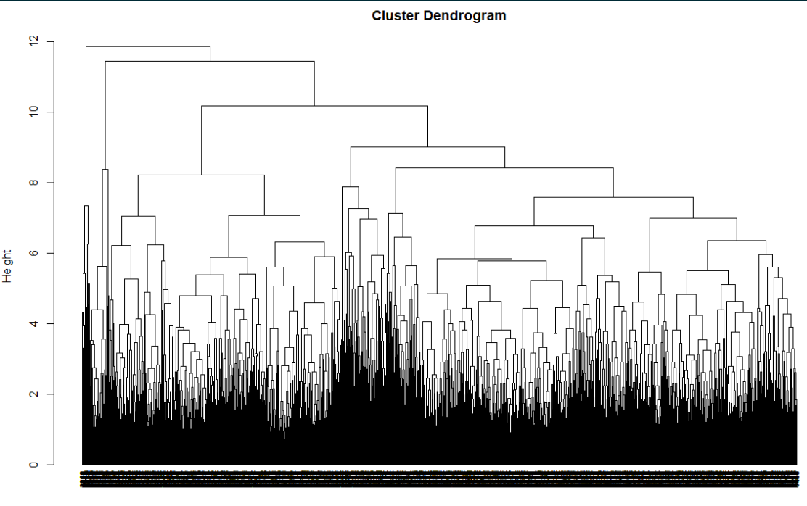
Hierarchical Clustering
Approximately 3-5 clusters due to high variability at the top of dendrogram
Complete distance measure was used to provide compact clusters with small variance within clusters.

Slide 7
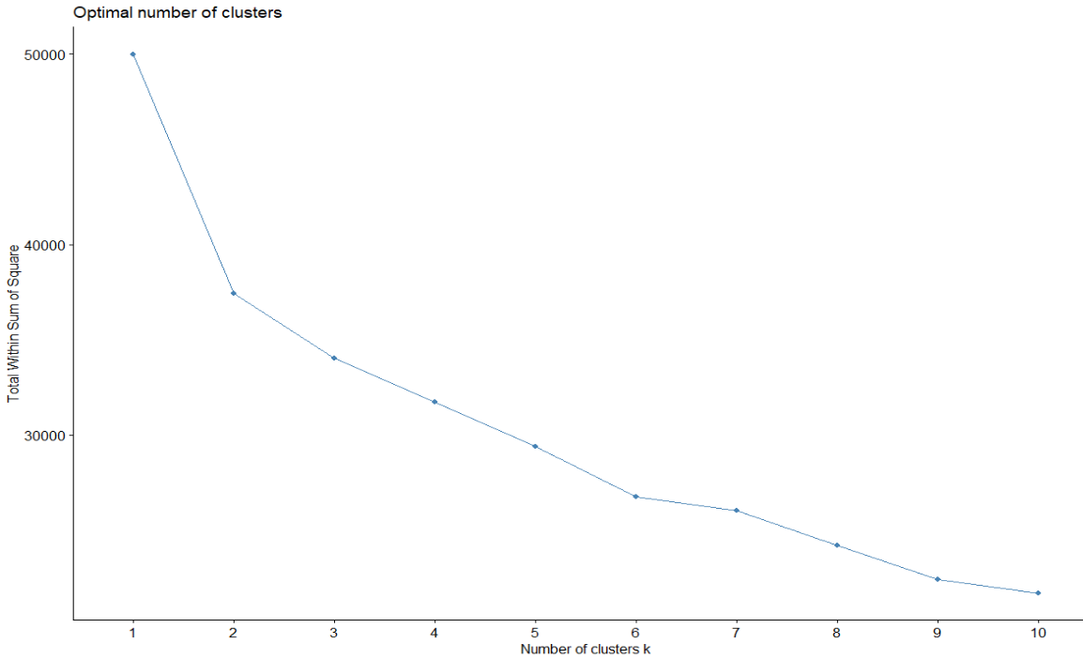
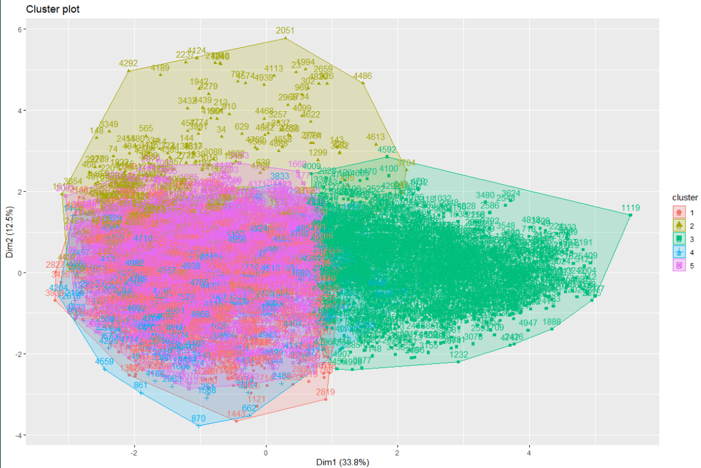
K-Means Clustering

Slide 8
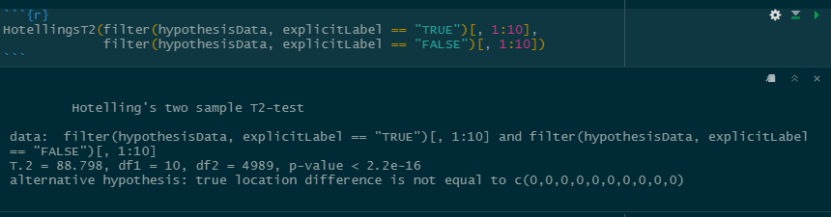
Hotelling’s T Test
Normality check using Shapiro test
Determinant check to ensure our data is non-singular matrix
Ran on TRUE/FALSE variable, α=0.05

Slide 9
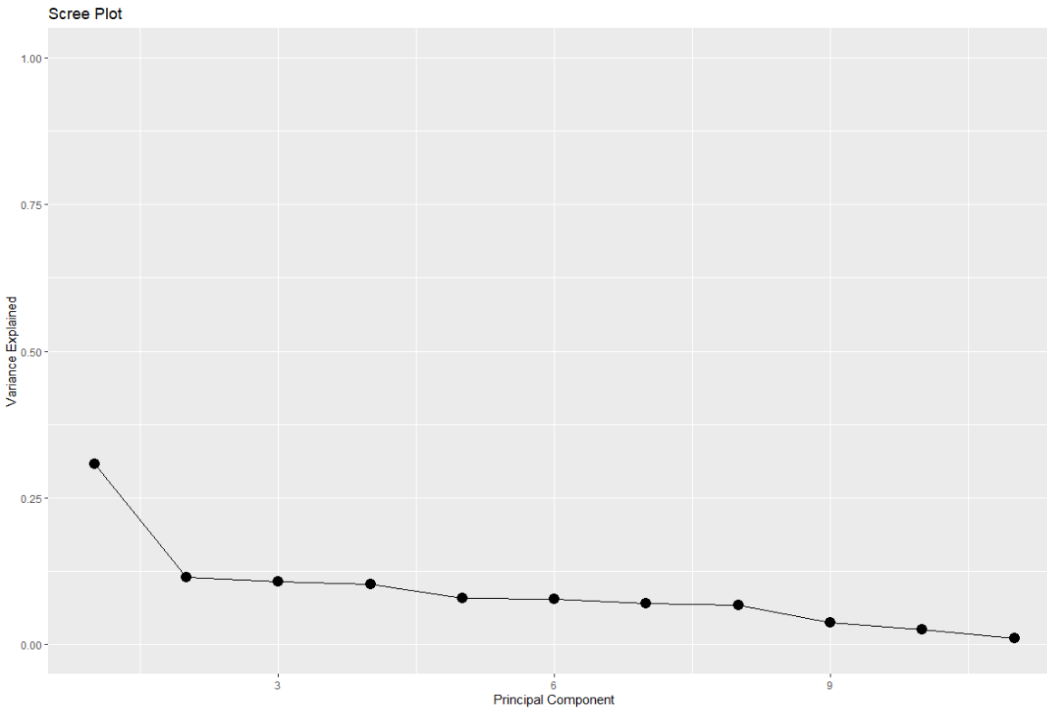
Principal Component Analysis (PCA)
Data normalization, then computing eigenvalues and vectors respectively
PCA not feasible due to even distribution of proportions of variances between components

Slide 10

Multidimensional Scaling (MDS)
Fed it distance matrix of our data previously from clustering task
Substandard result for computing our principal coordinates

Slide 11
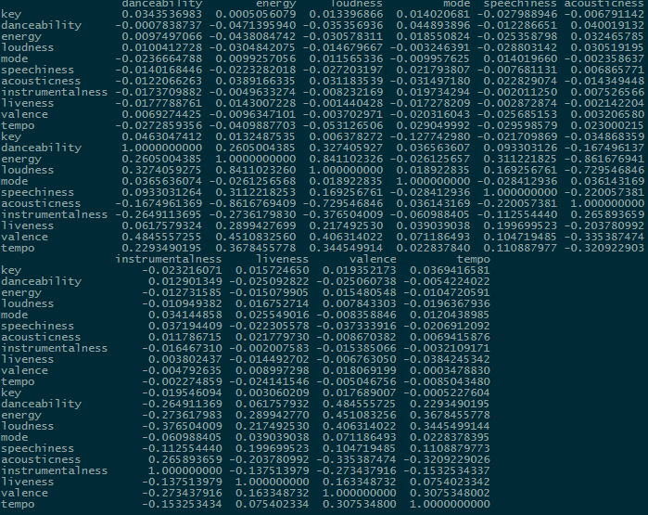
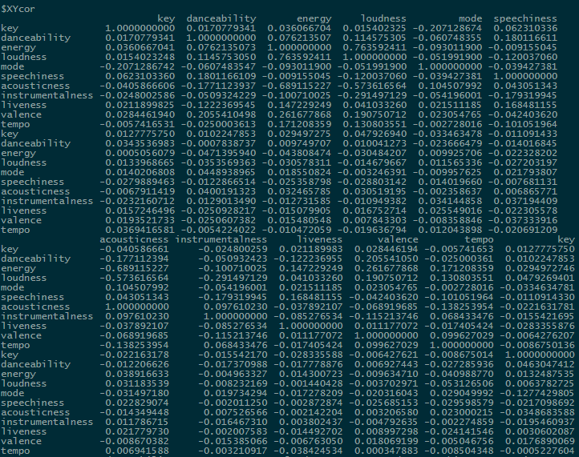
Canonical Correlation
Split our data in half by adjusting danceability feature to 0.36 for even split
PCA not feasible due to even distribution of proportions of variances between components

Slide 12
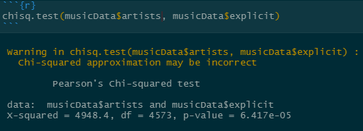
Measures of Association
Data contains very few features with meaningful categorical variables to perform association
Tried to see if certain artists correlated with their music being explicit or not
Independent test

Slide 13
Outlier Detection
Univariate
Bivariate
Multivariate
Box plots and histograms previously performed
Few outliers present in tempo, liveness, loudness, and speechiness
Plotted scatter matrix to find outliers
Not informative as some are discrete variables and checking outliers using scatter isn’t most informative
Used Mahalanobis distance, any observation with p value less than α=0.05 is considered outlier
~ 650 were found as potential outliers

Slide 14
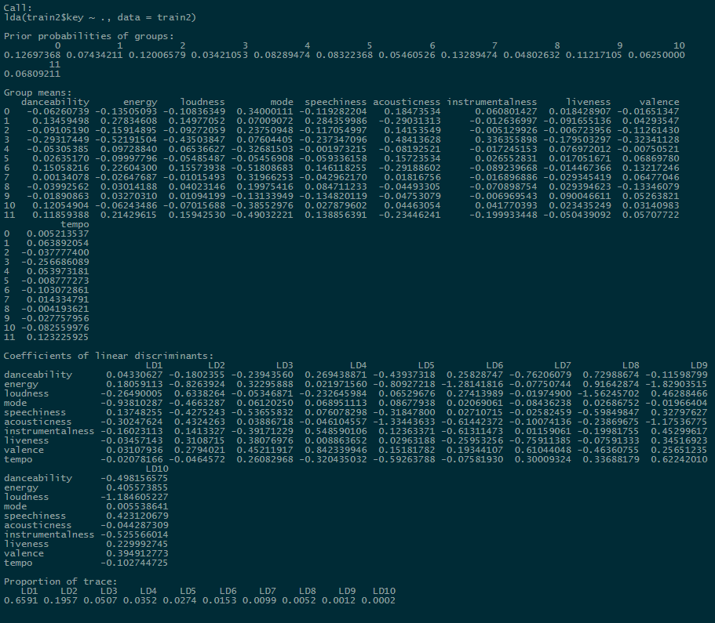
Remedial Actions (LDA)
LDA had very little difference in performance, MSE was almost negligible and proportion of trace was very similar

Slide 15
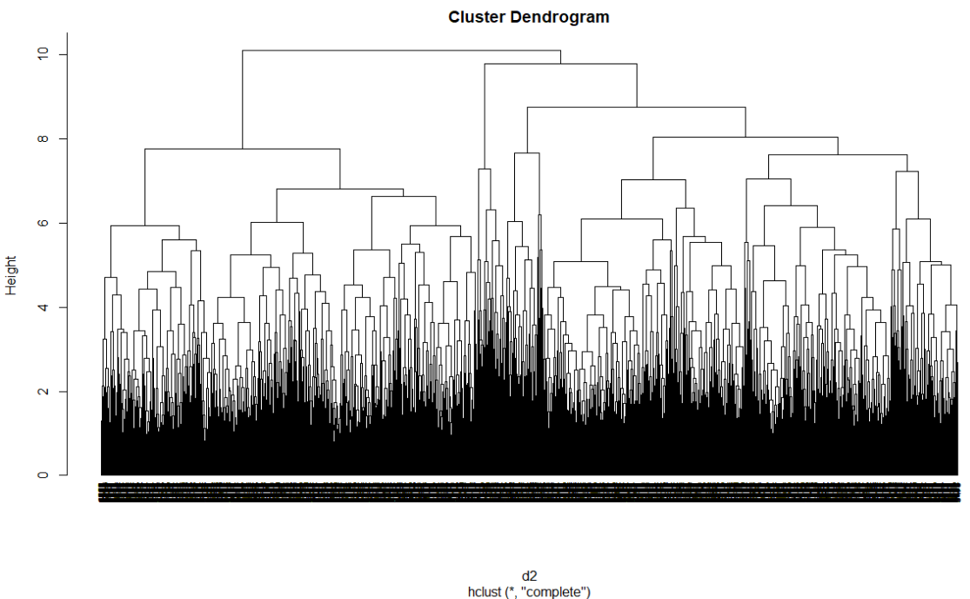
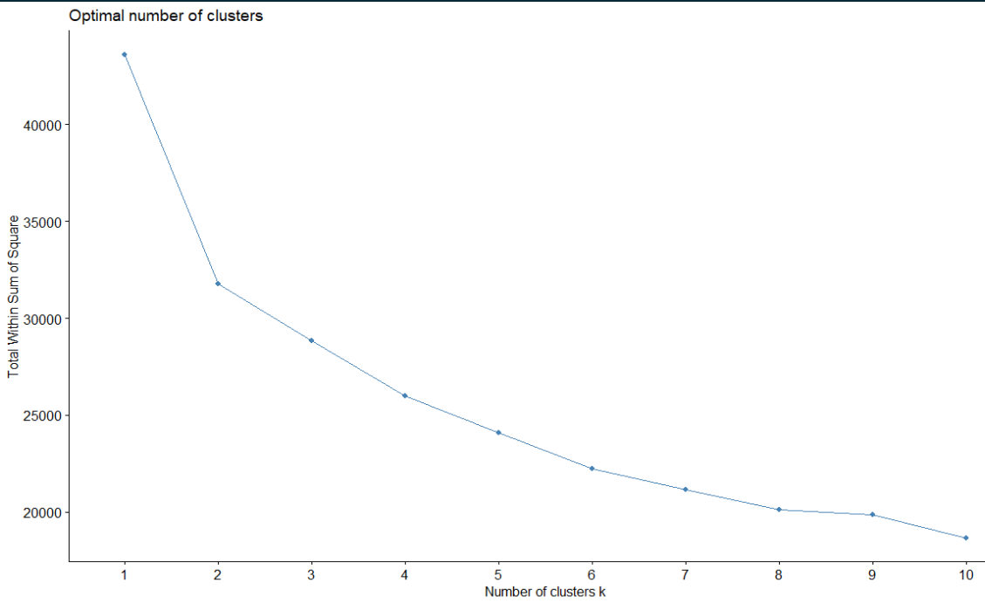
Remedial Actions (Clustering)
Hierarchical had more variability, potentially 4-7 clusters
K-means new elbow method at k=6, goodness of fit was similar but still below 50%, still subpar

Slide 16
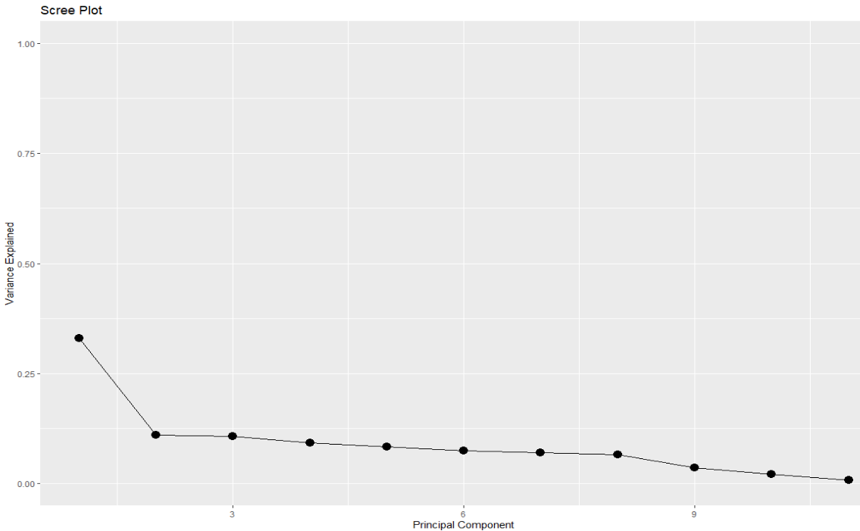
Remedial Actions (Hotelling, PCA, MDS, CanCor)
Hotelling Test was unaffected by outlier removal, test is still statistically significant
PCA wasn’t affected but proportion of variance was still unsuitable for using PCA further
MDS had a GOF of approximately 48%, a marginal improvement on first experiment
CanCor test shows max. correlation of 0.13, too small to suggest a relationship between two sets of data.

Slide 17
Conclusion
Provided various visualization and data mining techniques including:
LDA, PCA, MDS
Outlier Detection
Cluster Analysis
Canonical Correlation
Association Rules
Areas of Improvement:
Attempt to optimize performance of techniques
Improve preprocessing methods to optimize data being fed to our models such as PCA and LDA
Data is sampled from larger dataset, so it is skewed and might not be reliable

Slide 18
Thank you!
Questions?

